Slide 1

Game Theory Twelve
BNN Error Orders
Finite Difference Methods
Other Candidacy Topics
Jacob Wyngaard

Slide 2
Convergence of RK 4 Solution to Actual Solution
Two players each with two strategies, neither with a strictly dominant strategy
Player 1 Payoff Matrix
Player 2 Payoff Matrix
Player 2
Player 2
A
B
A
B
1
2 | 3
4 | 1
1
7 | 5
6 | 8
Player 1
Player 1
2
2
Player 1 Strategy:${ p}^{1}=(x^{1},y^{1})$ Player 2 Strategy:${ p}^{2}=(x^{2},y^{2})$

Slide 3
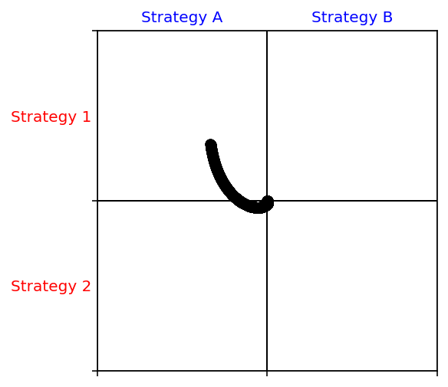
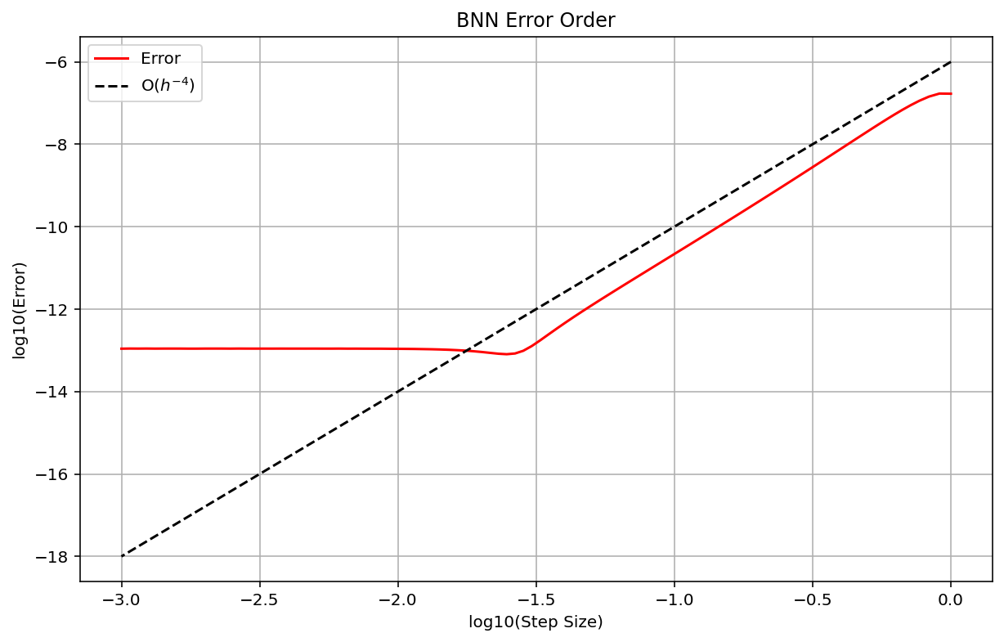

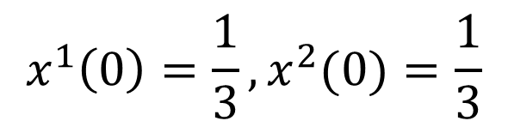
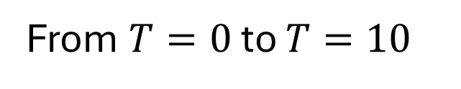
Convergence of RK 4 Solution to Actual Solution
$$x^{1}\left(0\right)=\frac{1}{3},x^{2}(0)=\frac{1}{3}$$
Activation Function
From $T=0$ to $T=10$
$$φ(x)=ln(1+e^{x})$$

Slide 4
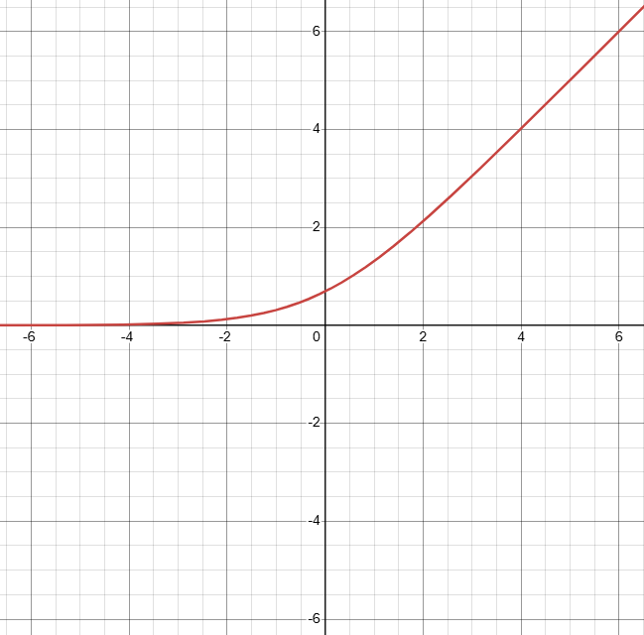
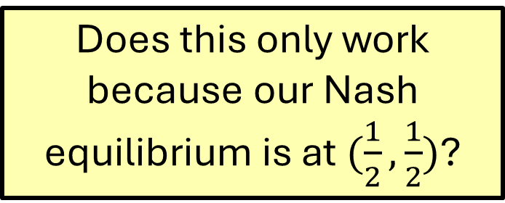

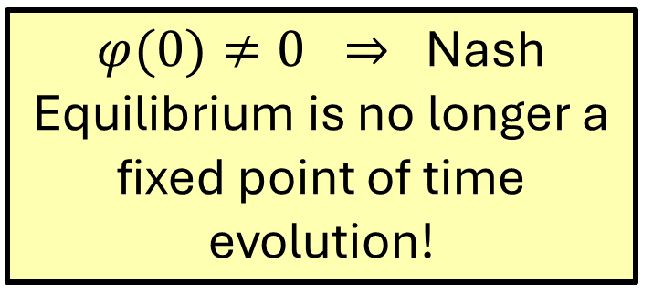


New Activation Function
$$y$$
Activation Function
$$φ(x)=ln(1+e^{x})$$
$φ(0)≠0 ⇒$Nash Equilibrium is no longer a fixed point of time evolution!
$$x$$
Does this only work because our Nash equilibrium is at $(\frac{1}{2},\frac{1}{2})$?

Slide 5
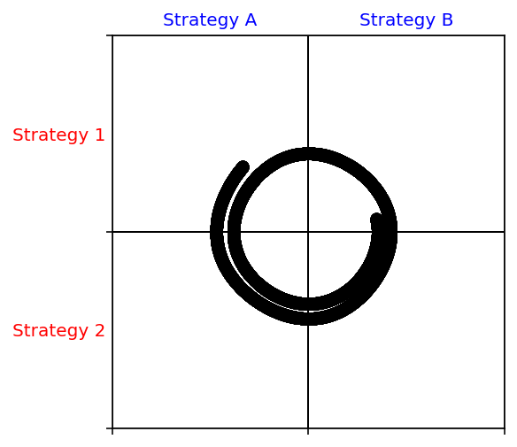
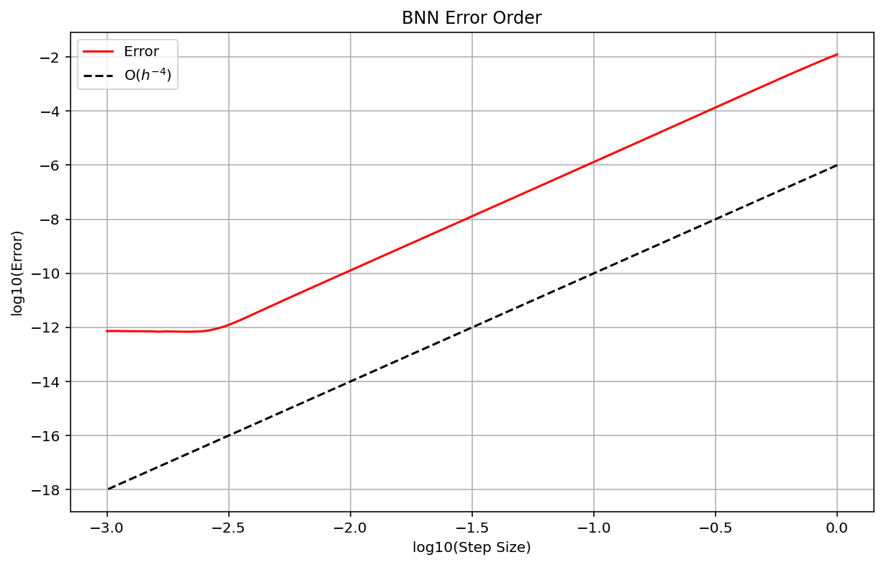
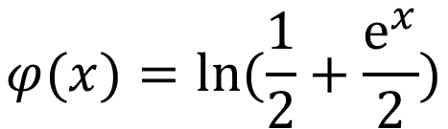
Changing the Activation Function
$$x^{1}\left(0\right)=\frac{1}{3},x^{2}(0)=\frac{1}{3}$$
Activation Function
$$φ(x)=ln(\frac{1}{2}+\frac{e^{x}}{2})$$
From $T=0$ to $T=10$

Slide 6
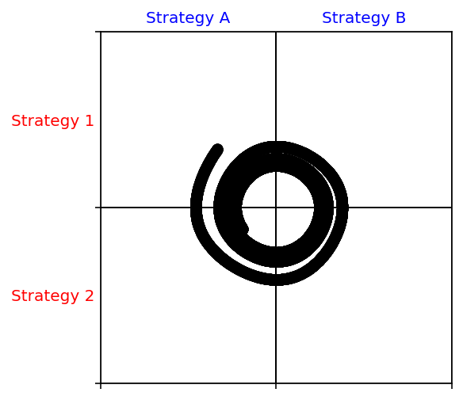
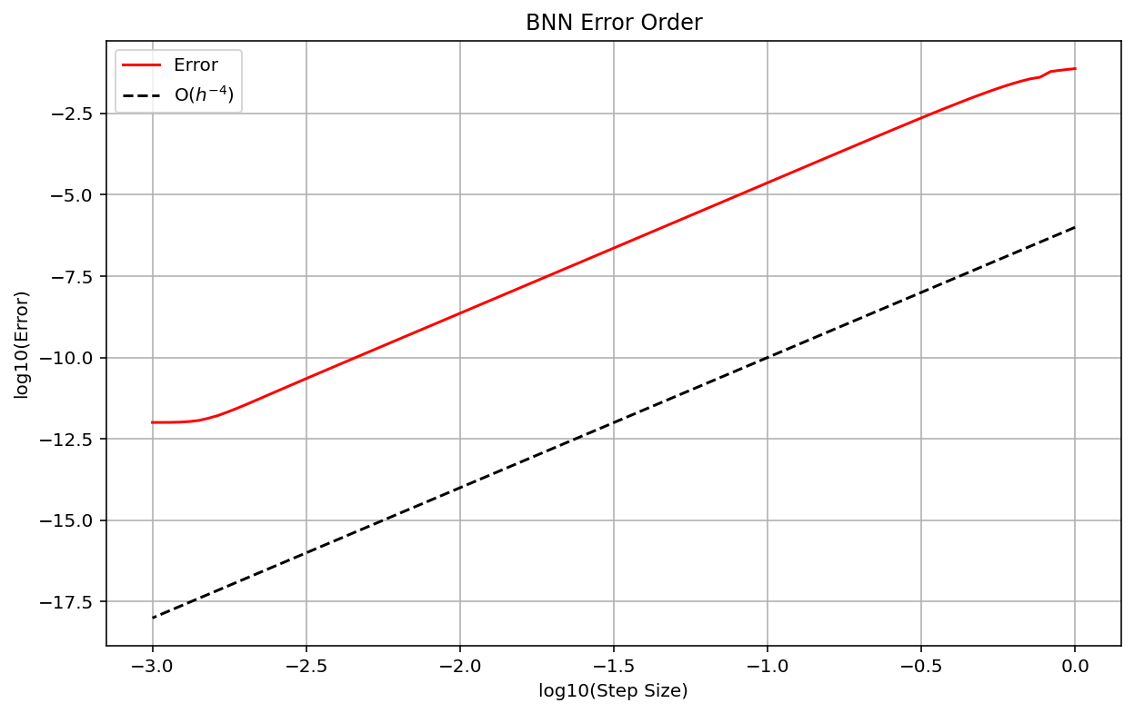

Changing the Activation Function
$$x^{1}\left(0\right)=\frac{1}{3},x^{2}(0)=\frac{1}{3}$$
Activation Function
$$φ(x)=ln(1+xe^{x})$$
From $T=0$ to $T=10$

Slide 7

$3×3$ BNN Dynamics Example
Player 1 Payoff Matrix
Player 2 Payoff Matrix
Player 2
Player 2
A
B
C
A
B
C
0 | 3 | 0
1 | 0 | 4
2 | 1 | 0
1 | 2 | 0
3 | 0 | 1
0 | 1 | 4
1
1
Player 1
Player 1
2
2
3
3
Player 1 Strategy:${ p}^{1}=(x^{1},y^{1},z^{1})$ Player 2 Strategy:${ p}^{2}=(x^{2},y^{2},z^{2})$

Slide 8
$3×3$ BNN Dynamics Example
First Nash Equilibrium: $(1,0,0)$ and $(0,1,0)$
Player 2
Player 2
A
B
C
A
B
C
0 | 3 | 0
1 | 0 | 4
2 | 1 | 0
1 | 2 | 0
3 | 0 | 1
0 | 1 | 4
1
1
Player 1
Player 1
2
2
3
3
Player 1 Strategy:${ p}^{1}=(x^{1},y^{1},z^{1})$ Player 2 Strategy:${ p}^{2}=(x^{2},y^{2},z^{2})$

Slide 9
$3×3$ BNN Dynamics Example
Second Nash Equilibrium: $(0,2/3,1/3)$ and $(4/5,0,1/5)$
Player 2
Player 2
A
B
C
A
B
C
0 | 3 | 0
1 | 0 | 4
2 | 1 | 0
1 | 2 | 0
3 | 0 | 1
0 | 1 | 4
1
1
Player 1
Player 1
2
2
3
3
Player 1 Strategy:${ p}^{1}=(x^{1},y^{1},z^{1})$ Player 2 Strategy:${ p}^{2}=(x^{2},y^{2},z^{2})$

Slide 10
$3×3$ BNN Dynamics Example
Third Nash Equilibrium: $(1/2,1/4,1/4)$ and $(2/5,2/5,1/5)$
Player 2
Player 2
A
B
C
A
B
C
0 | 3 | 0
1 | 0 | 4
2 | 1 | 0
1 | 2 | 0
3 | 0 | 1
0 | 1 | 4
1
1
Player 1
Player 1
2
2
3
3
Player 1 Strategy:${ p}^{1}=(x^{1},y^{1},z^{1})$ Player 2 Strategy:${ p}^{2}=(x^{2},y^{2},z^{2})$

Slide 11




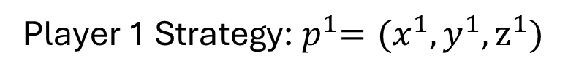
Player 1 $φ$ Functions
Player 1 Payoff Matrix
Player 1 Strategy:${ p}^{1}=(x^{1},y^{1},z^{1})$
Player 2
$$φ_{11}\left(p\right)=max⁡(0, 3y^{2}$$
A
B
C
$$−(3x^{1}y^{2}+y^{1}x^{2}+4y^{1}z^{2}+2z^{1}x^{2}+z^{1}y^{2}))$$
0 | 3 | 0
1 | 0 | 4
2 | 1 | 0
1
$$φ_{12}\left(p\right)=max⁡(0, x^{2}+4z^{2}$$
$$−(3x^{1}y^{2}+y^{1}x^{2}+4y^{1}z^{2}+2z^{1}x^{2}+z^{1}y^{2}))$$
Player 1
2
$$φ_{13}\left(p\right)=max⁡(0, 2x^{2}+y^{2}$$
3
$$−(3x^{1}y^{2}+y^{1}x^{2}+4y^{1}z^{2}+2z^{1}x^{2}+z^{1}y^{2}))$$

Slide 12
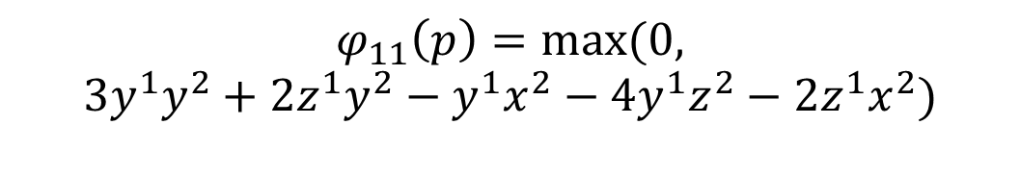
Player 1 $φ$ Functions
Player 1 Payoff Matrix
Player 1 Strategy:${ p}^{1}=(x^{1},y^{1},z^{1})$
Player 2
$$φ_{11}\left(p\right)=max⁡(0, 3y^{2}$$
A
B
C
$$−(3x^{1}y^{2}+y^{1}x^{2}+4y^{1}z^{2}+2z^{1}x^{2}+z^{1}y^{2}))$$
0 | 3 | 0
1 | 0 | 4
2 | 1 | 0
1
Can simplify with:
$${3y}^{2}={{3x}^{1}y}^{2}+{3y^{1}y}^{2}+{{3z}^{1}y}^{2}$$
Player 1
2
$$φ_{11}\left(p\right)=max⁡(0,$$
$${3y^{1}y}^{2}+2z^{1}y^{2}−y^{1}x^{2}−4y^{1}z^{2}−2z^{1}x^{2})$$
3

Slide 13

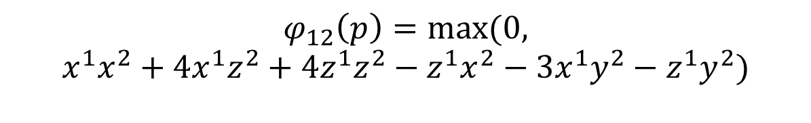
Player 1 $φ$ Functions
Player 1 Payoff Matrix
Player 1 Strategy:${ p}^{1}=(x^{1},y^{1},z^{1})$
Player 2
$$φ_{12}\left(p\right)=max⁡(0, x^{2}+4z^{2}$$
A
B
C
$$−(3x^{1}y^{2}+y^{1}x^{2}+4y^{1}z^{2}+2z^{1}x^{2}+z^{1}y^{2}))$$
0 | 3 | 0
1 | 0 | 4
2 | 1 | 0
1
Can simplify with:
$$x^{2}={x^{1}x}^{2}+{y^{1}x}^{2}+{z^{1}x}^{2}$$
Player 1
$${4z}^{2}=4{x^{1}z}^{2}+{4y^{1}z}^{2}+{4z^{1}z}^{2}$$
2
$$φ_{12}\left(p\right)=max⁡(0,$$
$${x^{1}x}^{2}+4{x^{1}z}^{2}+{4z^{1}z}^{2}−z^{1}x^{2}−3x^{1}y^{2}−z^{1}y^{2})$$
3

Slide 14
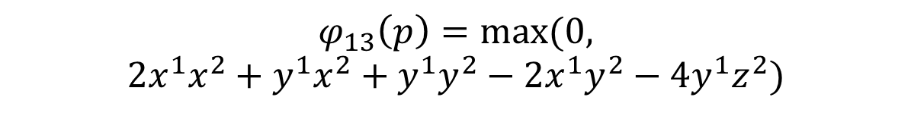

Player 1 $φ$ Functions
Player 1 Payoff Matrix
Player 1 Strategy:${ p}^{1}=(x^{1},y^{1},z^{1})$
Player 2
$$φ_{13}\left(p\right)=max⁡(0, 2x^{2}+y^{2}$$
A
B
C
$$−(3x^{1}y^{2}+y^{1}x^{2}+4y^{1}z^{2}+2z^{1}x^{2}+z^{1}y^{2}))$$
0 | 3 | 0
1 | 0 | 4
2 | 1 | 0
1
Can simplify with:
$${2x}^{2}={2x^{1}x}^{2}+{{2y}^{1}x}^{2}+{{2z}^{1}x}^{2}$$
Player 1
$$y^{2}={x^{1}y}^{2}+{y^{1}y}^{2}+{z^{1}y}^{2}$$
2
$$φ_{13}\left(p\right)=max⁡(0,$$
$${2x^{1}x}^{2}+{y^{1}x}^{2}+{y^{1}y}^{2}−2x^{1}y^{2}−4y^{1}z^{2})$$
3

Slide 15




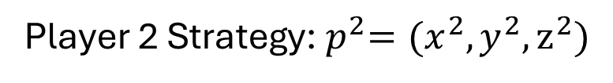
Player 2 $φ$ Functions
Player 2 Payoff Matrix
Player 2 Strategy:${ p}^{2}=(x^{2},y^{2},z^{2})$
Player 2
$$φ_{2A}\left(p\right)=max⁡(0, x^{1}+3y^{1}$$
A
B
C
$$−(x^{1}x^{2}+3y^{1}x^{2}+2x^{1}y^{2}+z^{1}y^{2}+y^{1}z^{2}+4z^{1}z^{2}))$$
1 | 2 | 0
3 | 0 | 1
0 | 1 | 4
1
$$φ_{2B}\left(p\right)=max⁡(0, {2x}^{1}+z^{1}$$
Player 1
$$−(x^{1}x^{2}+3y^{1}x^{2}+2x^{1}y^{2}+z^{1}y^{2}+y^{1}z^{2}+{4z}^{1}z^{2}))$$
2
$$φ_{2C}\left(p\right)=max⁡(0, y^{1}+{4z}^{1}$$
3
$$−(x^{1}x^{2}+3y^{1}x^{2}+2x^{1}y^{2}+z^{1}y^{2}+y^{1}z^{2}+4z^{1}z^{2}))$$

Slide 16

Both Players’ $φ$ Functions
$$φ_{11}\left(p\right)=max⁡(0, {3y^{1}y}^{2}+2z^{1}y^{2}−y^{1}x^{2}−4y^{1}z^{2}−2z^{1}x^{2})$$
$$φ_{12}\left(p\right)=max⁡(0,{x^{1}x}^{2}+4{x^{1}z}^{2}+{4z^{1}z}^{2}−z^{1}x^{2}−3x^{1}y^{2}−z^{1}y^{2})$$
$$φ_{13}\left(p\right)=max⁡(0,{2x^{1}x}^{2}+{y^{1}x}^{2}+{y^{1}y}^{2}−2x^{1}y^{2}−4y^{1}z^{2})$$
$$φ_{2A}\left(p\right)=max⁡(0,{x^{1}z}^{2}+3{y^{1}y}^{2}+2y^{1}z^{2}−x^{1}y^{2}−z^{1}y^{2}−{4z^{1}z}^{2})$$
$$φ_{2B}\left(p\right)=max⁡(0,{x^{1}x}^{2}+2{x^{1}z}^{2}+z^{1}x^{2}−3{y^{1}x}^{2}−y^{1}z^{2}−{3z^{1}z}^{2})$$
$$φ_{2C}\left(p\right)=max⁡(0,{y^{1}y}^{2}+4z^{1}x^{2}+3z^{1}y^{2}−{x^{1}x}^{2}−2x^{1}y^{2}−2{y^{1}x}^{2})$$

Slide 17
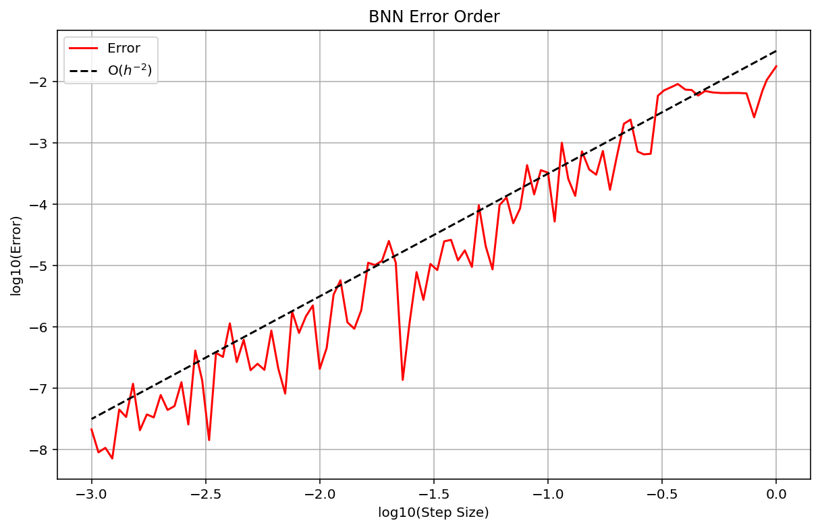

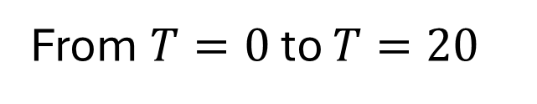
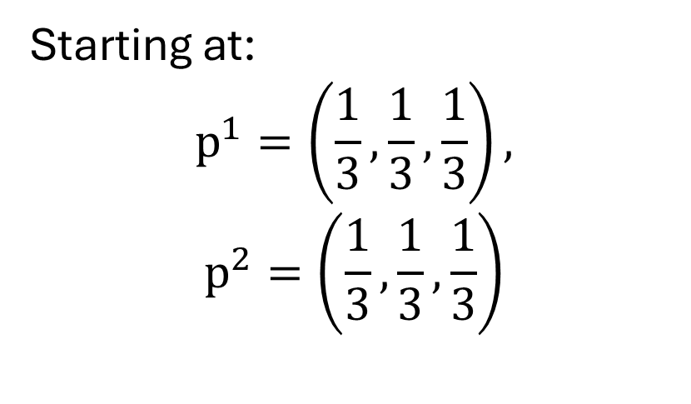
$3×3$ BNN Dynamics Example: Error Orders
Starting at:
$$p^{1}=\left(\frac{1}{3},\frac{1}{3},\frac{1}{3}\right),$$
$$p^{2}=\left(\frac{1}{3},\frac{1}{3},\frac{1}{3}\right)$$
From $T=0$ to $T=20$
“Actual Solution” Solved Using Adaptive Runge Kutta

Slide 18
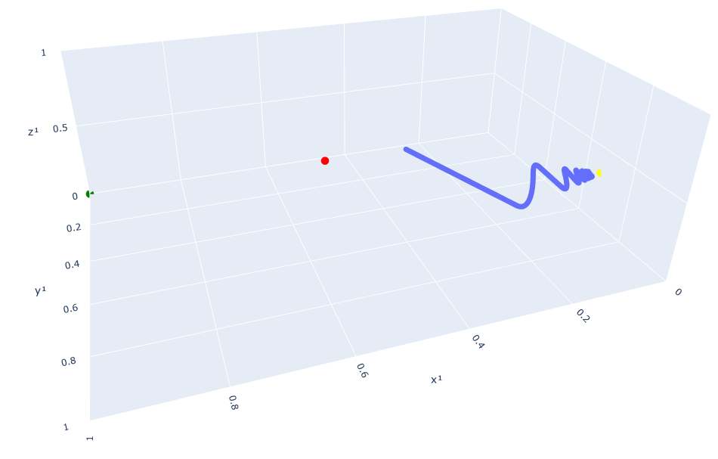
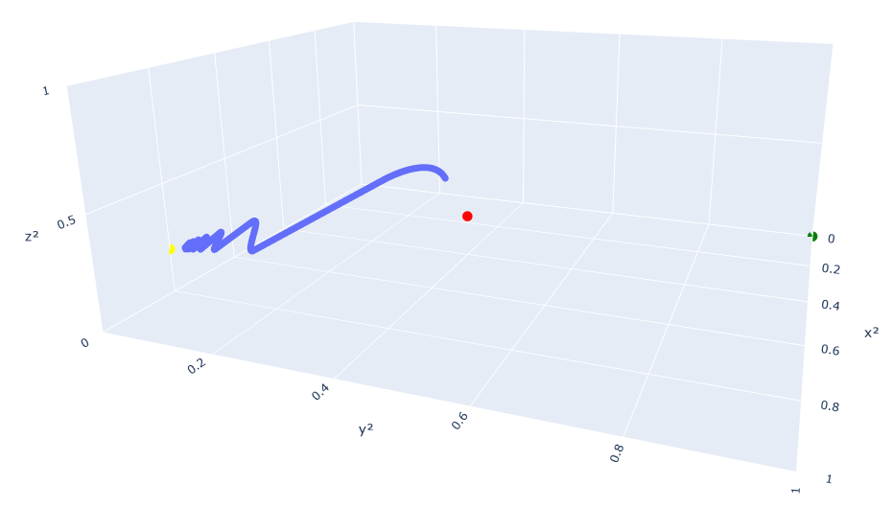
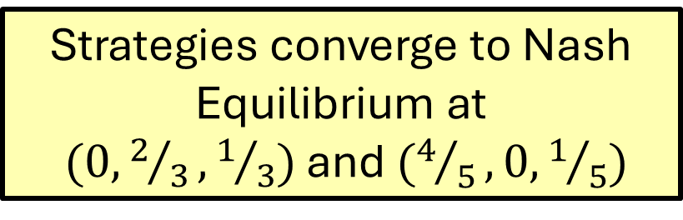
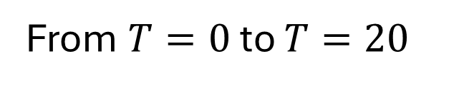

$3×3$ BNN Dynamics Example: Strategy Dynamics
Starting at: $p^{1}=\left(\frac{1}{3},\frac{1}{3},\frac{1}{3}\right),p^{2}=\left(\frac{1}{3},\frac{1}{3},\frac{1}{3}\right)$
Strategies converge to Nash Equilibrium at
$(0,2/3,1/3)$ and $(4/5,0,1/5)$
From $T=0$ to $T=20$

Slide 19
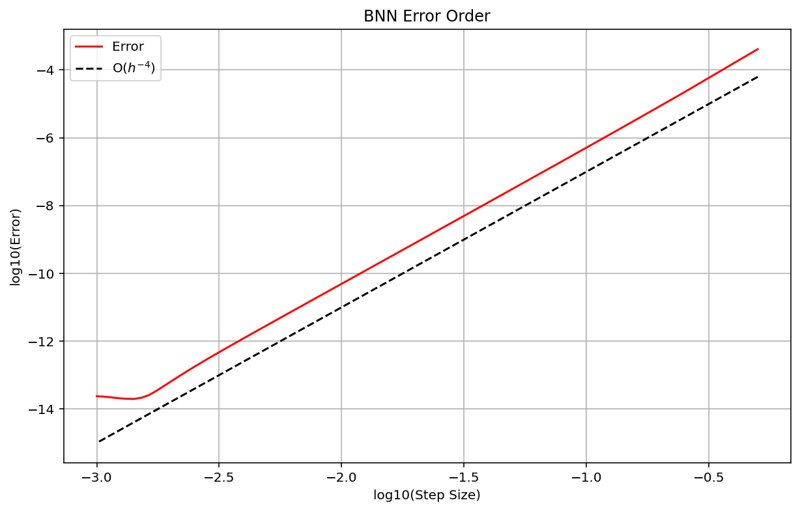

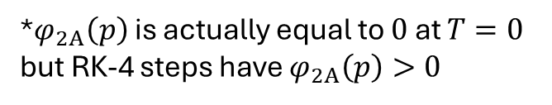


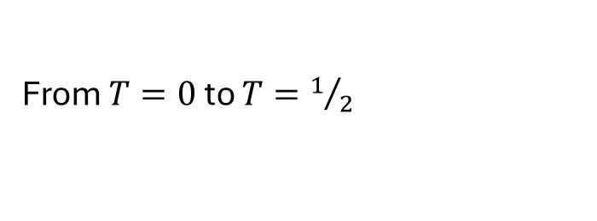

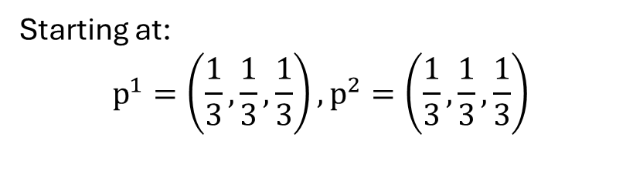


$3×3$ BNN Dynamics Example: Error Orders
Starting at:
$$p^{1}=\left(\frac{1}{3},\frac{1}{3},\frac{1}{3}\right),p^{2}=\left(\frac{1}{3},\frac{1}{3},\frac{1}{3}\right)$$
From $T=0$ to $T=1/2$
For both times:
$$φ_{11}\left(p\right)=0$$
$$φ_{12}\left(p\right)>0$$
$$φ_{13}\left(p\right)=0$$
$$φ_{2A}\left(p\right)>0$$
$$φ_{2B}\left(p\right)=0$$
$$φ_{2C}\left(p\right)>0$$
*$φ_{2A}\left(p\right)$ is actually equal to $0$ at $T=0$ but RK-4 steps have $φ_{2A}\left(p\right)>0$
Consistent Jacobian ensures 4th Order Convergence

Slide 20
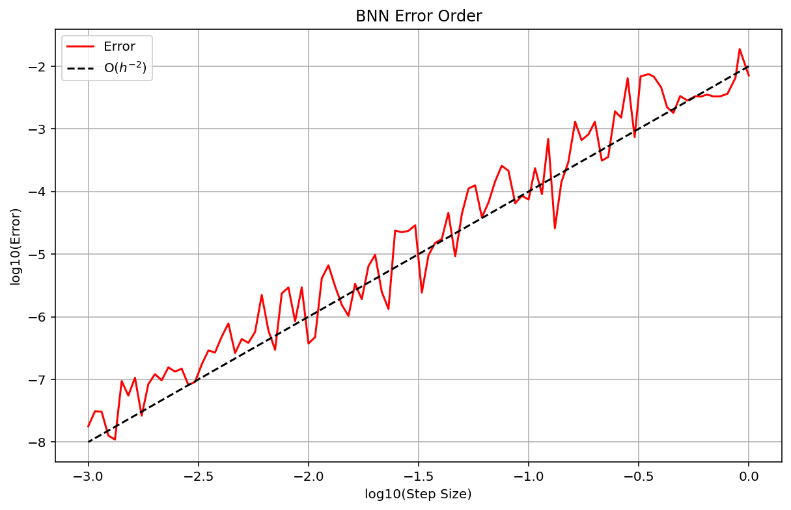
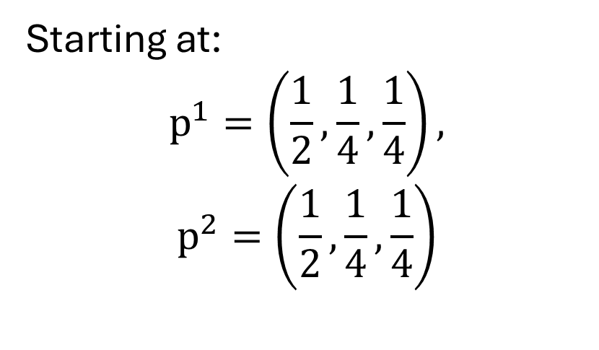
$3×3$ BNN Dynamics Example: Error Orders
Starting at:
$$p^{1}=\left(\frac{1}{2},\frac{1}{4},\frac{1}{4}\right),$$
$$p^{2}=\left(\frac{1}{2},\frac{1}{4},\frac{1}{4}\right)$$
From $T=0$ to $T=20$
“Actual Solution” Solved Using Adaptive Runge Kutta

Slide 21
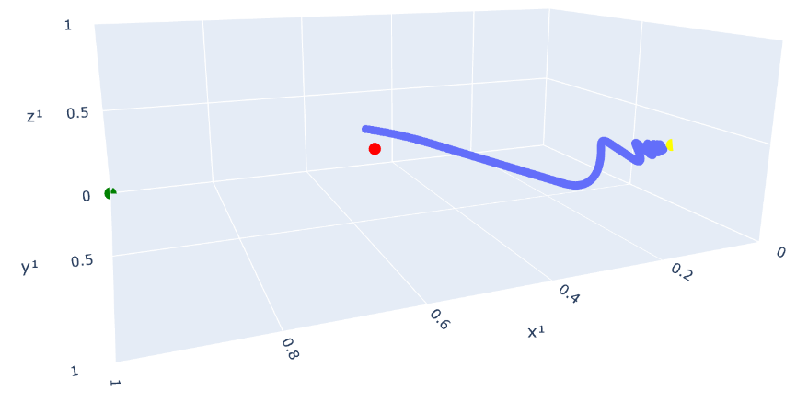

$3×3$ BNN Dynamics Example: Strategy Dynamics
Starting at: $p^{1}=\left(\frac{1}{2},\frac{1}{4},\frac{1}{4}\right),p^{2}=\left(\frac{1}{2},\frac{1}{4},\frac{1}{4}\right)$
Strategies converge to Nash Equilibrium at
$(0,2/3,1/3)$ and $(4/5,0,1/5)$
From $T=0$ to $T=20$

Slide 22
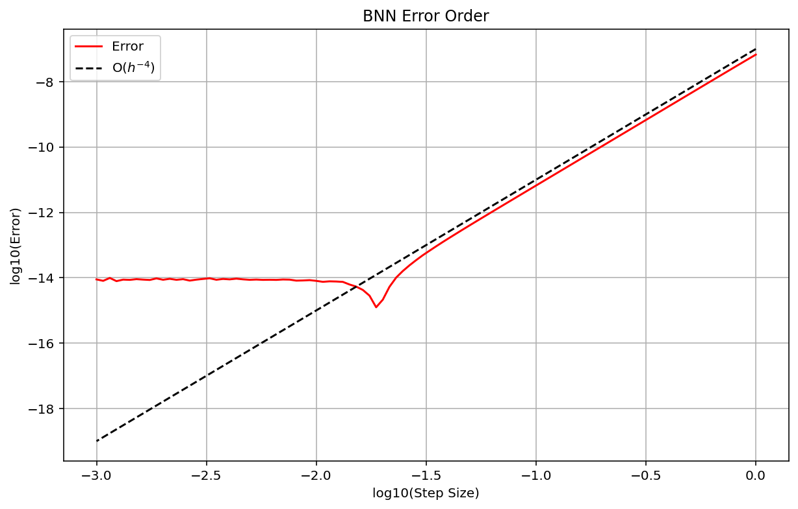
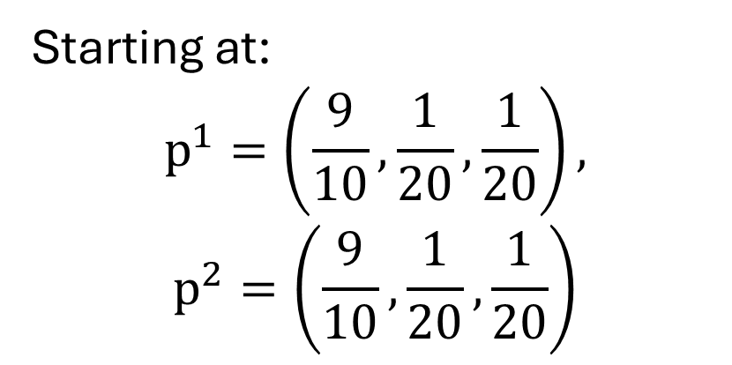
$3×3$ BNN Dynamics Example: Error Orders
Starting at:
$$p^{1}=\left(\frac{9}{10},\frac{1}{20},\frac{1}{20}\right),$$
$$p^{2}=\left(\frac{9}{10},\frac{1}{20},\frac{1}{20}\right)$$
From $T=0$ to $T=20$
“Actual Solution” Solved Using Adaptive Runge Kutta

Slide 23
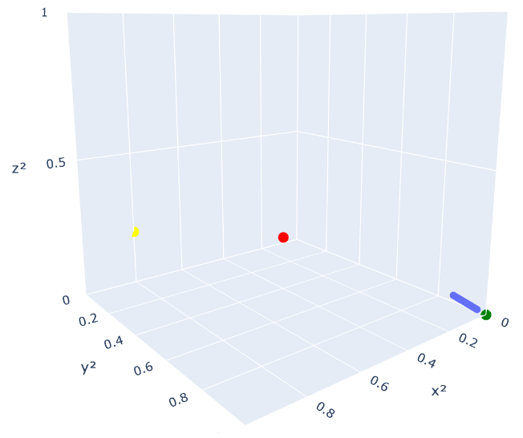
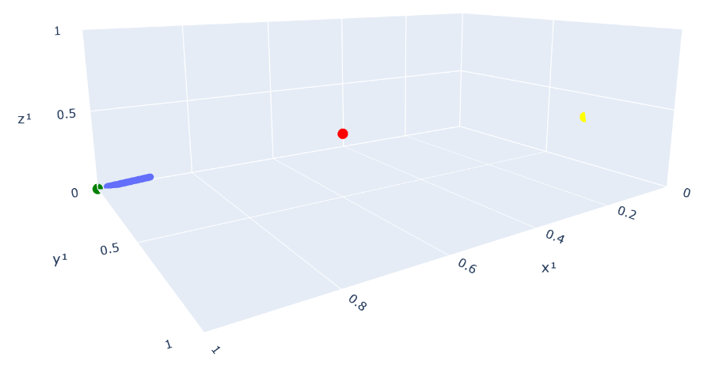
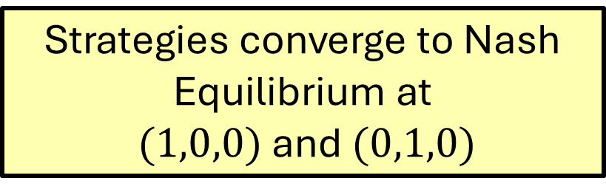
$3×3$ BNN Dynamics Example: Strategy Dynamics
Starting at: $p^{1}=\left(\frac{1}{2},\frac{1}{4},\frac{1}{4}\right),p^{2}=\left(\frac{1}{2},\frac{1}{4},\frac{1}{4}\right)$
Strategies converge to Nash Equilibrium at
$(1,0,0)$ and $(0,1,0)$
From $T=0$ to $T=20$

Slide 24
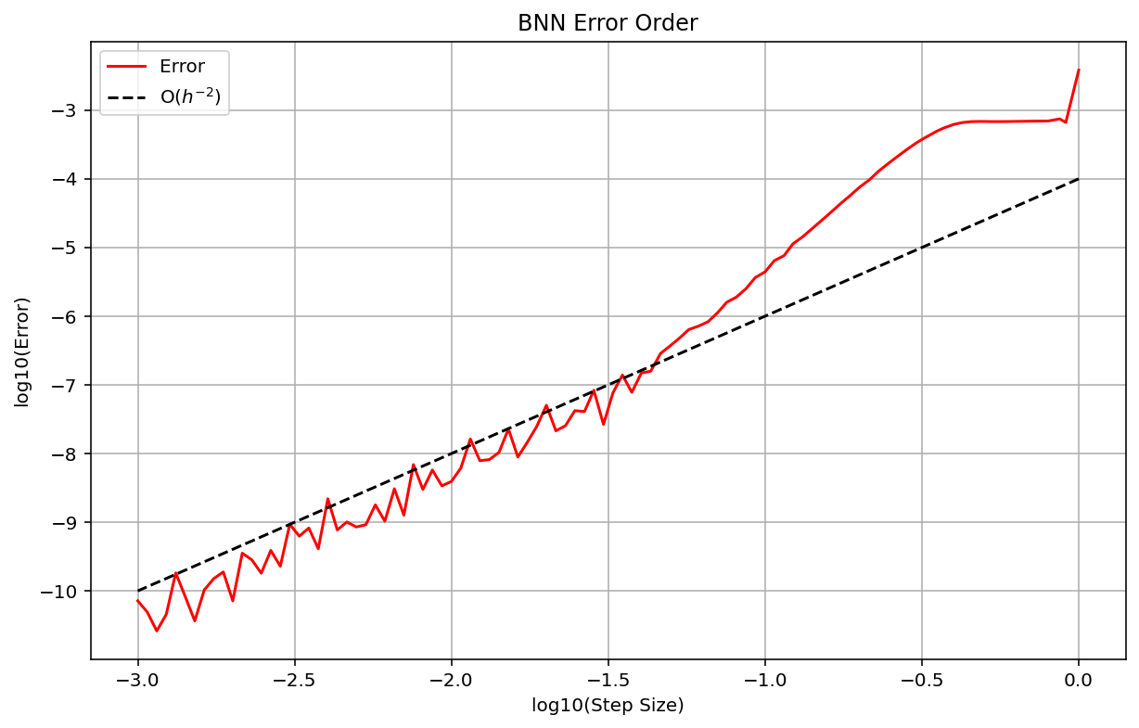
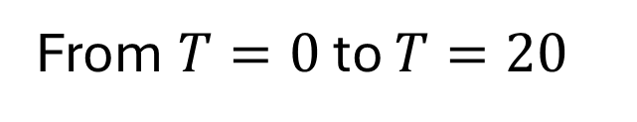
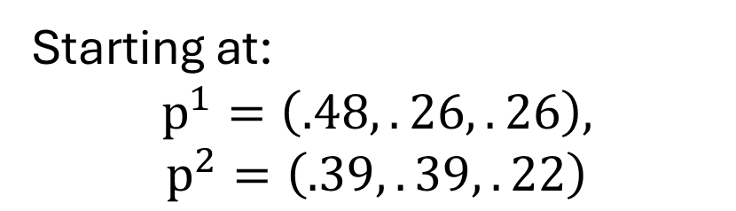
$3×3$ BNN Dynamics Example: Error Orders
Starting at:
$$p^{1}=\left(.48,.26,.26\right),$$
$$p^{2}=\left(.39,.39,.22\right)$$
From $T=0$ to $T=20$
“Actual Solution” Solved Using Adaptive Runge Kutta

Slide 25
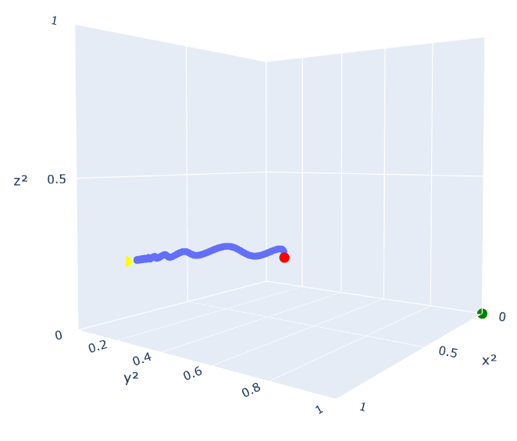
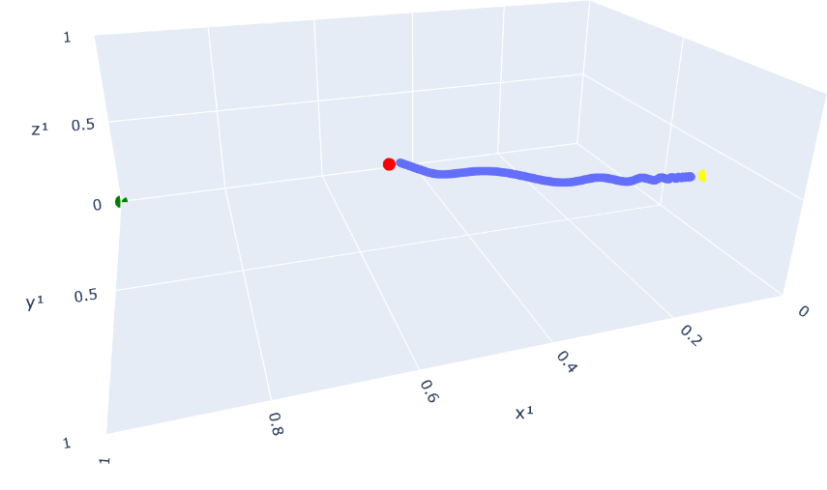

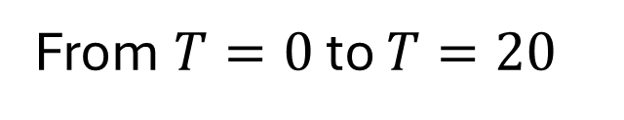
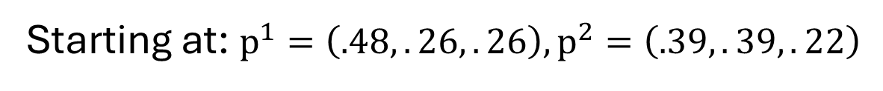
$3×3$ BNN Dynamics Example: Strategy Dynamics
Strategies converge to Nash Equilibrium at
$(0,2/3,1/3)$ and $(4/5,0,1/5)$
Starting at: $p^{1}=\left(.48,.26,.26\right),p^{2}=\left(.39,.39,.22\right)$
From $T=0$ to $T=20$

Slide 26

“Finite Difference Methods …” by LeVeque
Chapter 1: Finite Difference Approximations
Chapter 2: Steady States and Boundary Value Problems
Chapter 5: The Initial Value Problem for Ordinary Differential Equations
Chapter 7: Absolute Stability for Ordinary Differential Equations
Chapter 8: Stiff Ordinary Differential Equations
Chapter 9: Diffusion Equations and Parabolic Problems

Slide 27
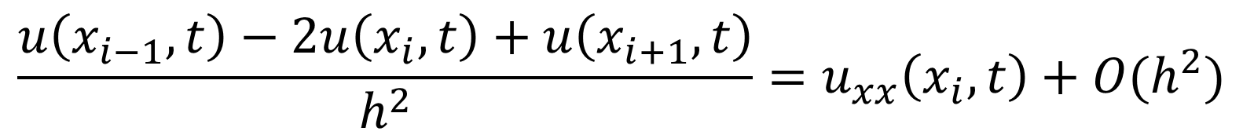
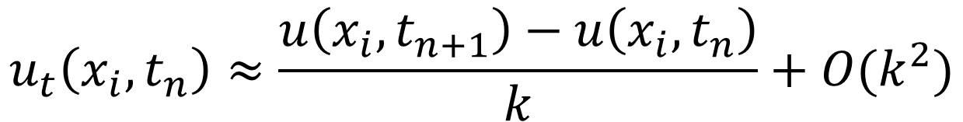
Chapter 1: Finite Difference Approximations
Using Taylor series expansions to approximate derivatives:
First Derivative
$$\frac{u\left(x_{i−1},t\right)−2u\left(x_{i},t\right)+u\left(x_{i+1},t\right)}{h^{2}}=u_{xx}\left(x_{i},t\right)+O(h^{2})$$
Second Derivative
$$u_{t}\left(x_{i},t_{n}\right)≈\frac{u\left(x_{i},t_{n+1}\right)−u\left(x_{i},t_{n}\right)}{k}+O(k^{2})$$

Slide 28
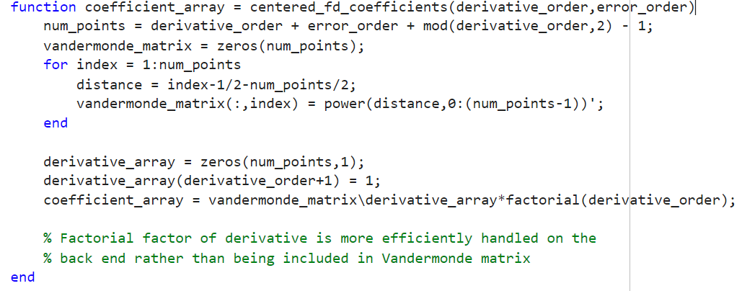
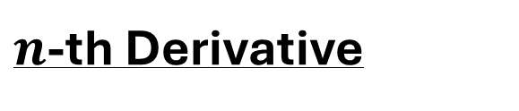
Chapter 1: Finite Difference Approximations
$n$-th Derivative

Slide 29
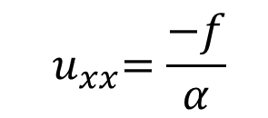
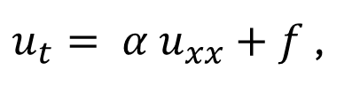



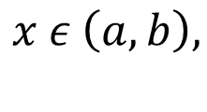
Chapter 2: Steady States and Boundary Value Problems
Consider the heat equation:
$u_{t}= {α u}_{xx}+f$ ,
$$x ε \left(a,b\right),$$
$$t>0$$
Boundary Value Problems
$${ u}_{xx}=\frac{−f}{α}$$
At steady state, $u_{t}= 0$ and
We are given $u(a)=A$ and $u(b)=B$
Initial Value Problems
We are given the initial conditions $u(x,0)=u_{0}(x)$
If the PDE is second-order in time, $u_{t}(x,0)=v_{0}(x)$ is also given
Pure Boundary Value Problems ignore time evolution, Pure Initial Value Problems ignore spatial boundaries

Slide 30

Chapter 2: Steady States and Boundary Value Problems
Consider the heat equation:
$u_{t}= {α u}_{xx}+f$ ,
$$x ε \left(a,b\right),$$
$$t>0$$
Initial Boundary Value Problems
We are given an initial condition $u(x,0)=u_{0}(x)$ and one of the following boundary conditions:
$u(a,t)=α(t)$ and $u(b,t)=β(t)$ for all $t>0$ [Dirichlet Boundary Conditions]
$u_{x}(a,t)=α(t)$ and $u_{x}(b,t)=β(t)$ for all $t>0$ [Neumann Boundary Conditions]
$u(a,t)+c_{1}∗ u_{x}(a,t)=α(t)$ and $u(b,t)+c_{2}∗ u_{x}(b,t)=β(t)$ for all $t>0$
[Robin Boundary Conditions]

Slide 31




Chapter 2: Steady States and Boundary Value Problems
Local and Global Errors
We want to look at how error propagates
Let $A$ be our linear operator, $\hat{U}$ our numerical solution vector and $U$ our actual solution
$A\hat{U}=AU+τ$ where $τ$ represents local error
Defining our global error as $E=U−\hat{U}$, $E=−A^{−1}τ$
Note that both$A^{−1}$ and $τ$ (and thus $E$) depend on our step size $h$
Stability:
$$\lim_{h→0}{||A^{−1}||} < ∞$$
Consistency:
$$\lim_{h→0}{||τ||} = 0$$
Convergence:
$$\lim_{h→0}{||E||} = 0$$
Stability + Consistency $⇒$ Convergence

Slide 32

Chapter 5: The Initial Value Problem for Ordinary Differential Equations
5.3 Some Basic Numerical Methods
Give the ordinary differential equation $u′(t) = f(t)$ and defining $\hat{U}$ as our numerical solution vector , we can define some basic numerical methods:
Forward Euler: $\frac{U^{n+1}−U^{n}}{k}=f(U^{n})$
Backward Euler: $\frac{U^{n+1}−U^{n}}{k}=f(U^{n+1})$ [Implicit Method]
Trapezoid: $\frac{U^{n+1}−U^{n}}{k}= \frac{1}{2}(f\left(U^{n}\right)+f\left(U^{n+1}\right))$ [Implicit Method]

Slide 33

Chapter 5: The Initial Value Problem for Ordinary Differential Equations
5.3 Some Basic Numerical Methods
Multistep Methods
Leapfrog: $\frac{U^{n+1}−U^{n−1}}{2k}=f(U^{n})$
Backward Differentiation: $\frac{{3U}^{n+1}−{4U}^{n}+U^{n−1}}{2k}=f(U^{n+1})$

Slide 34


Chapter 5: The Initial Value Problem for Ordinary Differential Equations
5.4 Truncation Errors
Plugging in Taylor series into numerical methods to get error orders
Example: Leapfrog Method
$\frac{U^{n+1}−U^{n−1}}{2k}=f\left(U^{n}\right)$
$$U^{n+1}=u\left(t_{n}\right)+u^{′}\left(t_{n}\right)k+1/2u^{′′}\left(t_{n}\right)k^{2}+1/6u^{′′′}\left(t_{n}\right)k^{3}+…$$
$$U^{n−1}=u\left(t_{n}\right)−u^{′}\left(t_{n}\right)k+1/2u^{′′}\left(t_{n}\right)k^{2}−1/6u^{′′′}\left(t_{n}\right)k^{3}+…$$
Given $u^{′}\left(t_{n}\right)=f\left(U^{n}\right)$, $\frac{U^{n+1}−U^{n−1}}{2k}=f\left(U^{n}\right)+1/6u^{′′′}\left(t_{n}\right)k^{2}+O(k^{4})$
Local Truncation Error:$1/6u^{′′′}\left(t_{n}\right)k^{2}+O(k^{4})$

Slide 35


Chapter 7: Absolute Stability for Ordinary Differential Equations
7.2 Absolute Stability
Given the eigenvalues of the Jacobian $λ_{i}$ and step size $k$, we want to make sure that each $z_{i}=λ_{i}k$ is in the stability region of the numerical method
If a $z_{i}$ is outside the stability region, then local errors can be magnified over time

Slide 36

Chapter 7: Absolute Stability for Ordinary Differential Equations
7.3 Stability Regions for Linear Multistep Methods
To determine the stability region for a linear multistep method, we first write the linear multistep method as a stability polynomial:
$$\sum_{j=0}^{m}{α_{j}U^{n+j}=\sum_{j=0}^{m}{β_{j}k{f(U}^{n+j}}})$$
Assume $k{f(U}^{n+j})=zU^{n+j}$ and $U^{j}=ξ^{j}$
$$⇒ \sum_{j=0}^{m}{(α_{j}−β_{j}z) ξ^{j}=0}$$
The stability region is the set of points $z$ such that all roots $ξ$of the stability polynomial have magnitude less than or equal to one
To the power of

Slide 37

Chapter 7: Absolute Stability for Ordinary Differential Equations
7.3 Stability Regions for Linear Multistep Methods
Stability Polynomial:$\sum_{j=0}^{m}{(α_{j}−β_{j}z)ξ^{j}=0}$
Forward Euler: $U^{n+1}−U^{n}=kf\left(U^{n}\right)⇒ξ−1=z⇒ξ−(z+1)$
The root of this stability polynomial is $ξ=z+1$
The stability region for forward Euler is the region $|z+1|≤1$
Trapezoid: $U^{n+1}−U^{n}=\frac{k}{2}f\left(U^{n}\right)+\frac{k}{2}f\left(U^{n+1}\right)⇒ξ−1=\frac{z}{2}+\frac{z}{2}ξ⇒\left(1−\frac{z}{2}\right)ξ−\left(1+\frac{z}{2}\right)=0$
The root of this stability polynomial is $ξ=\frac{1+\frac{z}{2}}{1−\frac{z}{2}}$
The stability region for forward Euler is the region $|\frac{1+\frac{z}{2}}{1−\frac{z}{2}}|≤1$, the region $Re(z)≥0$

Slide 38


Dr. Rizzolo Probability Topics
Brownian Motion and Stochastic Calculus by Karatzas and Shreve
Chapter 4: Brownian Motion and Partial Differential Equations
Chapter 5: Stochastic Differential Equations
Stochastic Processes and Applications: Diffusion Processes, the Fokker-Planck and Langevin Equations by Pavliotis
Chapter 4: The Fokker-Planck Equation
Chapter 5: Modeling with Stochastic Differential Equations

Slide 39

Dr. Guyenne Probability Topics
Derivation of Navier Stokes [Landau and Lifshitz 2.1]
Compressible vs Incompressible flow [Landau and Lifshitz 1.10]
Potential flow [Landau and Lifshitz 1.9]
- Definition of Hamiltonian systems and their basic properties. Good numerical methods for solving them.

